Slide 1
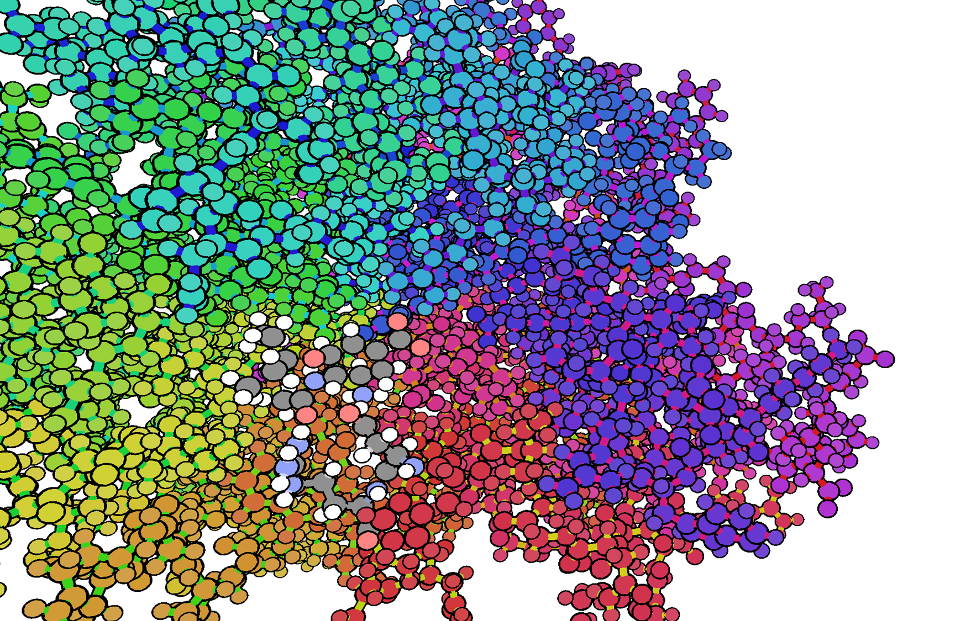
Code-your-own iMD-VR molecular simulations __________________________________________________________________
Becca Walters & Alex Jamieson-Binnie

Slide 2
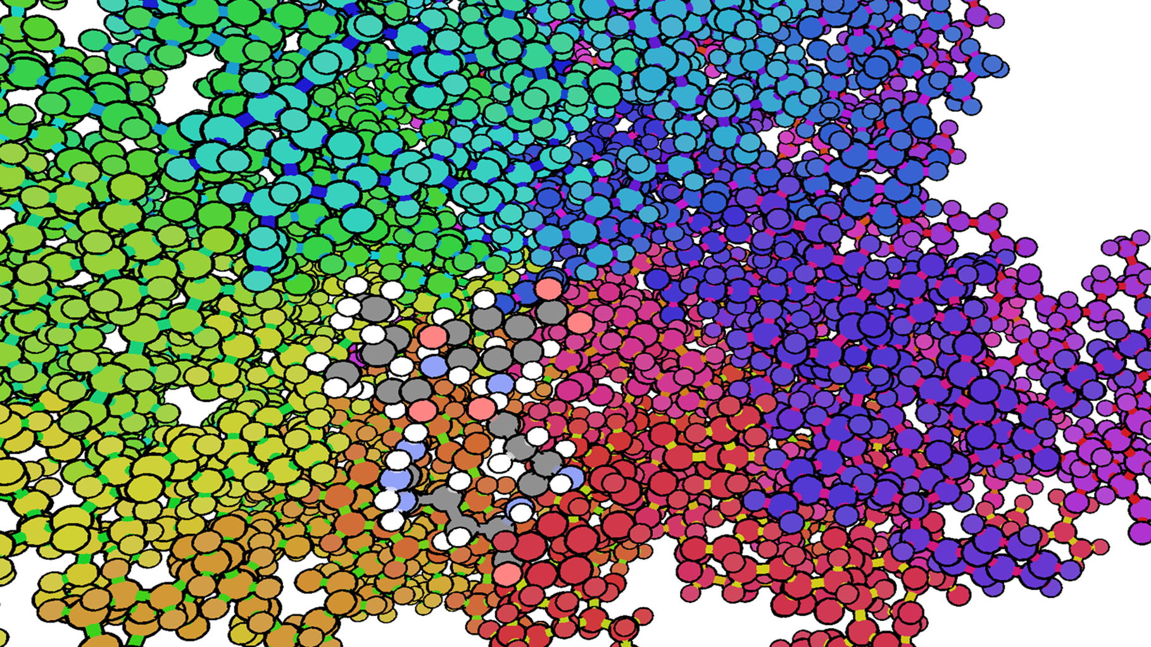
The future of molecular visualization/dynamics
NarupaXR is our own virtual reality software which allows users to visualize molecular systems and perform interactive molecular dynamics
This software gives you the ability to:
Visualize complicated protein structure in 3D
Generate on-the-fly molecular dynamics trajectories
Use these trajectories to generate free energy pathways and binding free-energies, which is incredibly impactful in terms of drug discovery

Slide 3
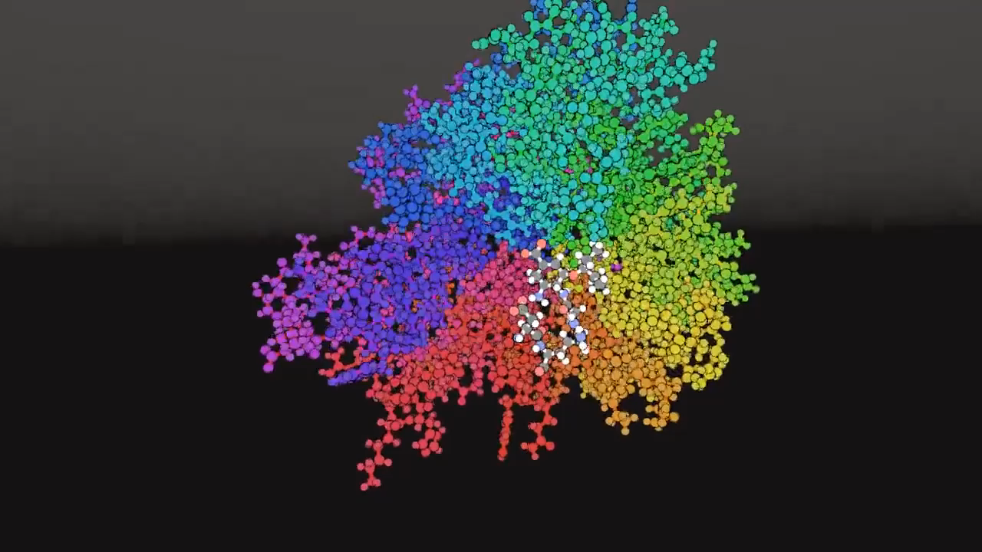

Slide 4
You will have the opportunity to:
Choose your favourite protein from an online database
Write a script that transforms this file into a VR simulation
Manipulate your chosen protein in VR
Edit your scripts to optimize the output you get from VR

Slide 5
Steps to follow
Choose protein in PDB database (3 choices, need to finalize these)
Install AmberTools19
Parameterize using tLEaP
Install OpenMM using Python
Make a python script to create topology (.xml) and coordinate (.pdb) file that NarupaXR can understand using OpenMM – HTML OPENMM DOCUMENTATION
Include path to xml template – FILE ON GITHUB
Use NarupaXR documentation to change: - HTML TO NARUPA DOCUMENTATION
Thermostat
Integrator
Add trajectory recorder

